Slide 1
ASP.NET MVC Tips and Tricks
Al Wilkinson

Slide 2
Hi! I’m Al ☺
First program in Logo in 1985 in 1st grade #loveatfirstbyte
Started HTML in 1996, led to web apps
Written device drivers, console apps, desktop apps, services, websites, and mobile apps
Worked as code monkey, dev team lead and manager, architect, and product lead
Currently at Balance Innovations working with web and mobile
Presentation available at: https://github.com/zealouscoder/presentations
Notes:
--Wrote my first program in Logo in 1985 in 1st grade, different forms of BASIC at various times through high school
--Started HTML in 1996 at University of Illinois as an engineering student, added JavaScript not long after and CSS once it was created and supported. Who remembers when font tags were the only option?
--Spent some time in some very different areas and different roles – intern at a large company working on graphics drivers and console apps; dev, architect, manager, product guy at a small company with a homegrown web Content Management System (CMS); a startup working on a desktop app and web add on; marketing firm / software shop on misc web projects.

Slide 3
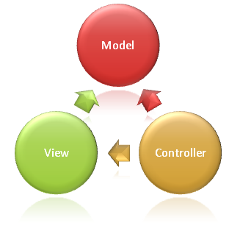
Why Are We Here?
MVC == Model – View – Controller
Focus on ASP.NET with C#
“The Wise Man Learns from the Mistakes of Others, The Fool Has to Learn from His Own” – old proverb
Notes:
--This is not an intro class so I assume you know that MVC == Model – View – Controller and understand the ideas behind the diagram or one of its variations
--Focusing on ASP.NET but many of the ideas here are applicable to other languages and other design patterns
--My overall goal comes from a smart developer who said if he learns something new in a training session, then he considers it worth the effort. So hopefully there is something new for you regardless of your experience level.
--<read quote> - if nothing else, this session is me sharing from many mistakes over the years…

Slide 4
Memory Lane
MVC 1 – 2009
.Net 3.5; VS 2008
MVC Pattern with Web Forms View Engine
Controller attributes like AcceptVerbs (Post, Get, etc)
Routing control
Html and Ajax helpers
MVC 2 – 2010
.Net 3.5, 4.0; VS 2008 & 2010
Strongly typed Html helpers
Asynchronous Controllers
Areas
ViewData
More helpers, utilities, enhancements
Notes:
--To gauge the experience and knowledge level here, who has worked with, or is working with, MVC 1? 2? 3? 4? 5?
--So I wanted to take a quick walk down memory lane and highlight just a few features in each version

Slide 5
Memory Lane
MVC 3 – 2011
.Net 4.0; VS 2010
Razor View Engine and support for multiple View Engines
HTML 5 templates
ViewBag
Global Action Filters (OnActionExecuting, OnException, etc)
Unobtrusive JavaScript client side validation and Remote attribute
MVC 4 – 2012
.Net 4.0, 4.5; VS 2010, 2012
Web API
New Mobile project template
Bundling and Minifications
OAuth and OpenID support
Asynch Await
SignalR
Empty project template and NuGet integration in VS

Slide 6
Memory Lane
MVC 5 – 2013
.Net 4.5, 4.5.1, VS 2013
One ASP.NET and New Project options
New ASP.NET Identity and Authentication options
OWIN and Katana integration
More improvements and updates

Slide 7
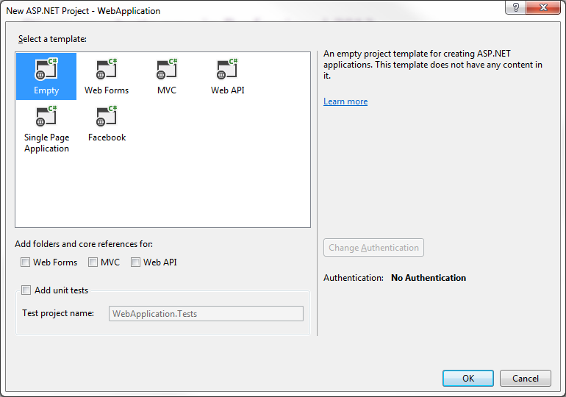
In The Beginning…
Recommend using Empty
Consider One ASP.NET options
Try each template – each adds some libraries and objects
Notes:
--You have to start somewhere, so let’s start with creating a new project
--I recommend using the Empty project when you are creating something for show. The others all add a bunch of nuget packages that you may or may not want to use. For example, are you using MVC 4? You get Knockout, Modernizr, and OAuth among others with the Web project
--One ASP.NET options are the ability to choose Web Forms, MVC, and/or Web API in the same project

Slide 8
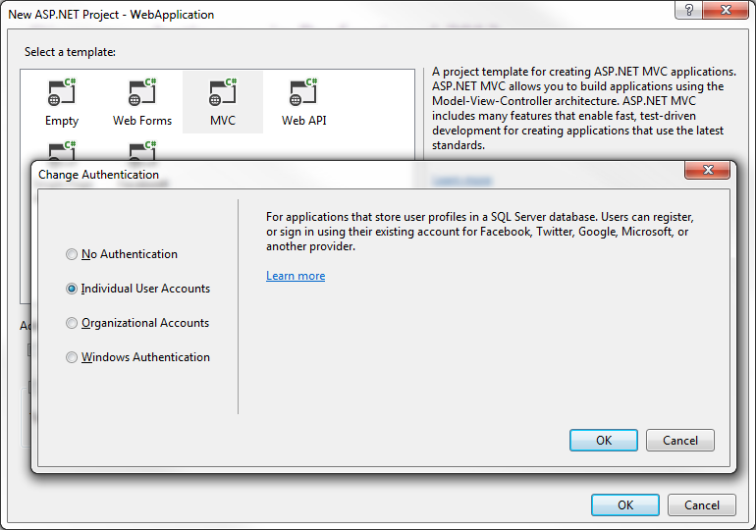
In the Beginning…
Web Forms, MVC, and Web API enable Change Authentication
Notes:
--If you are upgrading an existing project, make sure you find a good reference article that talks about changing the MVC related references in web.config and a strategy for updating or replacing nuget packages

Slide 9
Control Your Site
Remember the purpose of the Controller – KISS your actions
Consider the size and scope of the project
Create base controllers

Slide 10
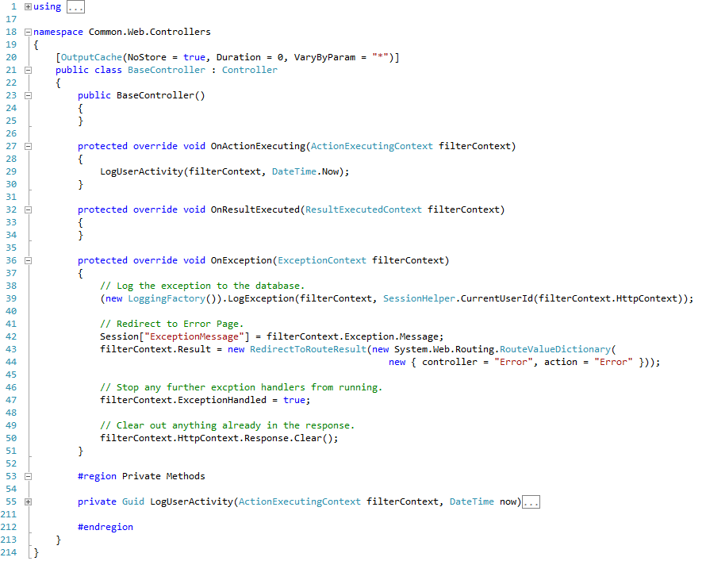
Control Your Site
Notes:
Be specific about when each is triggered
Reduce the need for try/catch in your code, though you will still need them
try/catch is more expensive than an if statement
Global.asax file things that get caught there instead of here

Slide 11
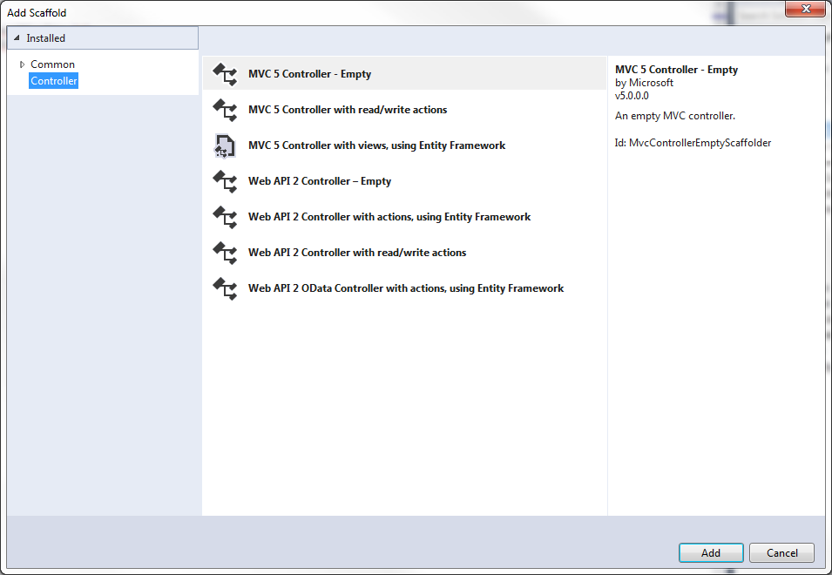
Control Your Site
MVC 5 adds new Add Controller provides many scaffolding options
Notes:
--WebAPI notes
Update to WebAPI 2 with MVC 5
Use XML comments to generate documentation
Identity is shared, Session is not readily shared
Requiring authentication
Attribute Routing
Handling Cross Origin Resource Sharing (CORS)
IHttpActionResult simplifies return responses
Consider code reuse and your own libraries

Slide 12
Control Your Site
Authentication and Authorization strategy
Customize routes, use good parameter names
Respond to validation errors
Choose good return types
Know your MV* pattern and what type of Controller you need
Notes:
--WebAPI notes
Update to WebAPI 2 with MVC 5
Use XML comments to generate documentation
Identity is shared, Session is not readily shared
Requiring authentication
Attribute Routing
Handling Cross Origin Resource Sharing (CORS)
IHttpActionResult simplifies return responses
Consider code reuse and your own libraries

Slide 13
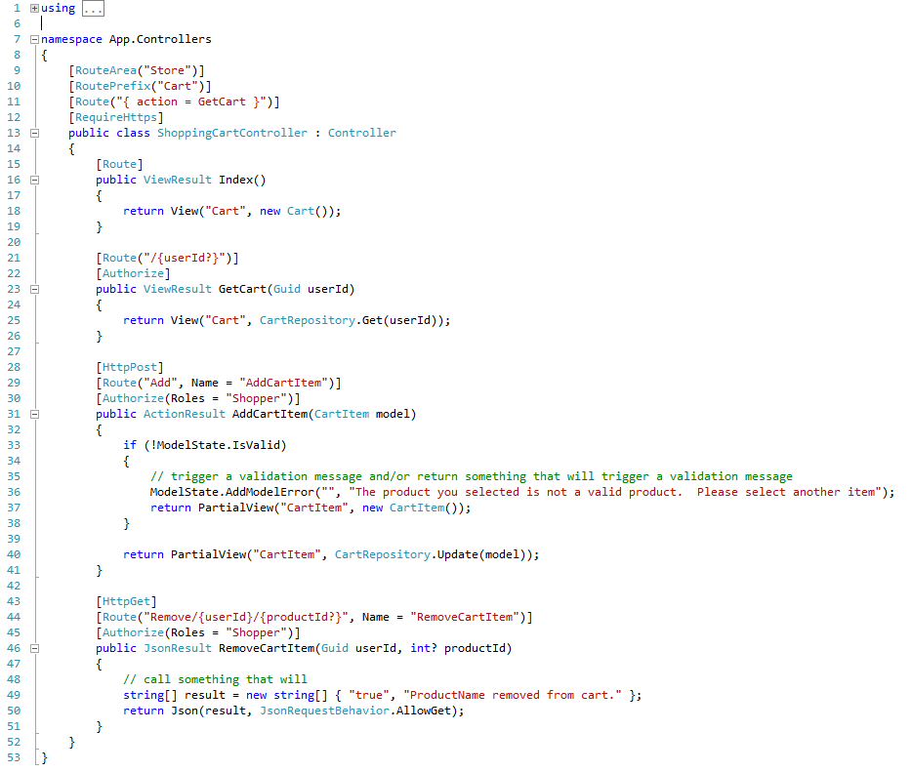
Control Your Site

Slide 14
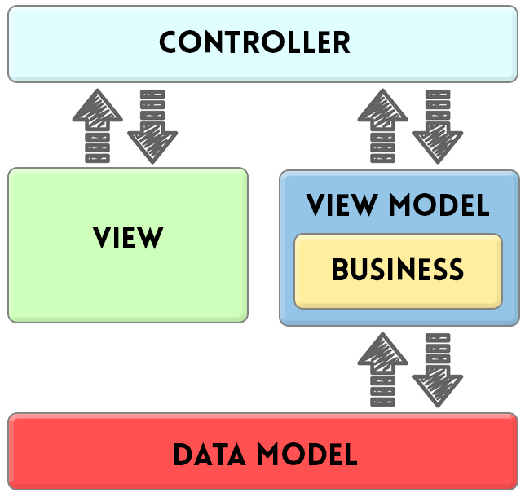
Show Me The Data
Data Model vs. View Model:
Data Model focuses on data persistence
View Model focuses on the View, client-side validation, and some formatting
Notes:
--Data Model vs View Model
--Entity class is another name I have seen for Data model
--We will look at a couple of view models in a minute. I am not showing data model examples here because there are too many factors to cover related to a data layer. So think ORM solutions like Entity Framework or others and consider code first or database first options, and if you head has not exploded with the possible discussion items, then your brain is doing better than mine ☺
--Attributes are one of my favorite features because there are so many things you can connect here to a property, while keeping the code and logic of it separated
--Just because you put an attribute there and it compiles does not mean it does what you expect
--Each version of MVC adds new ones, especially for validation. EmailAddress is a favorite

Slide 15
Show Me The Data
Initialize properties, especially collections
Use concrete classes
Display properties
Keep logic requirement in code, increases reusability
Consider globalization and localization
View Model as properties on other View Models behave differently
Required Attribute does not work
Use Editor Template to cover field specific validation
Consider Remote Attribute to cover broader validation
Be mindful of the User Experience with the flow of validation
Not all validation can occur before the page reloads
Know your MV* pattern
Notes:
--Display Properties should consider globalization and localization
--if this may be a requirement, take a little time to consider your structure → add string properties to handle tostrings and/or resource file references
--View Models with other View Models as properties change things a little
--In the next section we will talk about using EditorTemplates with these
--Required does not work on these
--The Remote attribute is useful but does not solve everything
--Know your MV* pattern
--May affect data types, where and when validation occurs, additional conversions to/from strings
--Structure of what is passed and what needs to be included in each class → Items property of Cart may be replaced with a ItemCount

Slide 16
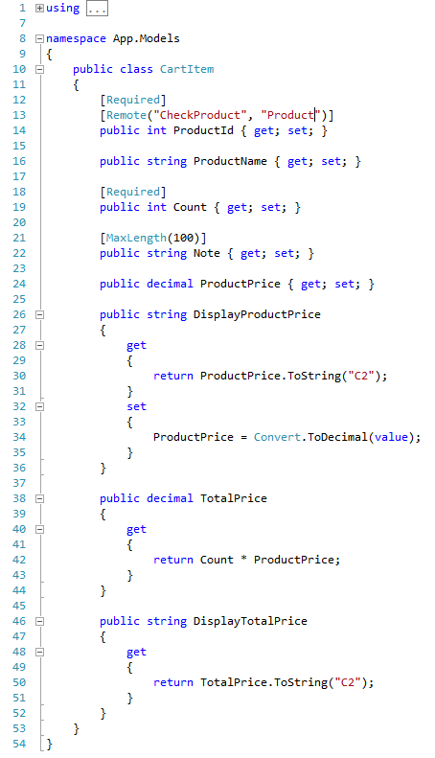
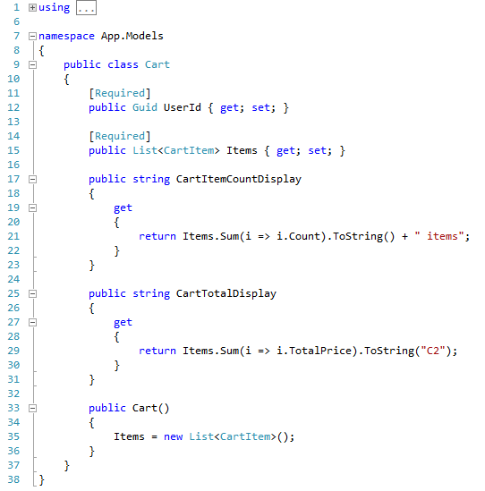
Model Examples

Slide 17
Do You See What I See? - Laying The Groundwork
_Layout is important, be intentional with it
Consider using meta viewport to help your site on mobile devices
Add RenderSection for JavaScript and CSS
Keep it simple, use partials for changeable parts
Decide where to put you JavaScript
Notes:
--Put all your properties in the View Model
--Skip ViewBag, ViewData, Session, etc as much as possible → that data should be in the View Model
--Always have a view model for a view, unless the view has no data, maybe something like an about page
--If you have logic beyond a loop or basic conditionals to show different partial views, consider adding properties to your view model or creating helpers
--Be careful with helpers, they are great for adding small things like custom links that have some logic around them. Set homepage link, label with required field indicator
--Your MV* pattern will dictate some of this structure and separation
--front end oriented MVVM will put little or no data on a page so you may not have any strongly typed views because they do not pass data in on the server side, and depending on how you scrape form data off the page when posting a form, you may or may not user editor template vs form collection
--server oriented MVC types will always have strongly typed views and pass that data in before loading

Slide 18
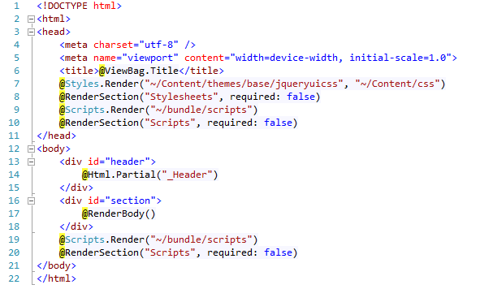
Do You See What I See? - Laying The Groundwork

Slide 19
Do You See What I See? – The Guts
Strongly type your views
Put all your properties in the View Model
Minimize code – keep logic and formatting code in code
Your properties should already be initialized and not null
Check counts and flags if there is a question about what to display
Create Helpers for small mixes of code and display
Consider RouteLink over ActionLink
Match View Models to each nested View, Editor Template, or Display Template
Nest carefully
Always pass the collection
Never pass nulls
Know your MV* pattern
Know what devices and screen resolutions you support
Mobile is not so much a question of “If?”, rather “First?”
Do not do client side browser name and version checks, rather do feature checks and server side framework checks (Request.Browser.IsMobileDevice)
Notes:
--Put all your properties in the View Model
--Skip ViewBag, ViewData, Session, etc as much as possible → that data should be in the View Model
--Always have a view model for a view, unless the view has no data, maybe something like an about page
--If you have logic beyond a loop or basic conditionals to show different partial views, consider adding properties to your view model or creating helpers
--Be careful with helpers, they are great for adding small things like custom links that have some logic around them.
--Some examples: RequiredFieldLabelFor, ImageLink, ListBoxFor
--RouteLink has a little performance boost by more efficiently finding which route to use
--Nest carefully issues
--crossing can kill the EditorFor
--nest anything does not execute @section
--nesting EditorFor works as long as it matches the layers of your View Model
--Your MV* pattern will dictate some of this structure and separation
--front end oriented MVVM will put little or no data on a page so you may not have any strongly typed views because they do not pass data in on the server side, and depending on how you scrape form data off the page when posting a form, you may or may not user editor template vs form collection
--server oriented MVC types will always have strongly typed views and pass that data in before loading

Slide 20
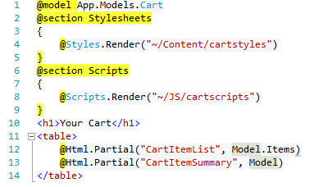
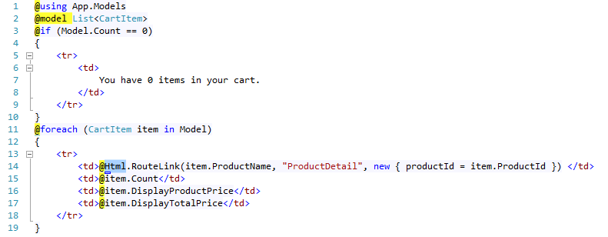
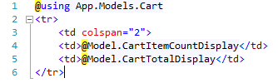
Do You See What I See? – The Guts

Slide 21
Config Transforms
Web.Config vs database for configuration settings
Web.Config for infrastructure and rarely changing settings – server names, IP addresses, client name, database connection string
Database for system functionality and more often change – layout template, features on/off, how many items per page
Consider encrypting all or sensitive portions of .config files
Use Transforms to manage settings for different servers
Add: xdt:Transform="Replace" xdt:Locator="Match(name)“
Notes:
Web.Config:
<add name="Entity" connectionString=“…” />
Web.Prod.Config:
<add name=“ProdEntity" connectionString=“…” xdt:Transform="Replace" xdt:Locator="Match(name)“ />
--You can do some transforms with VS out of the box, or add the Slow Cheetah plugin to add a little functionality for previewing and testing transforms

Slide 22

Config Transforms

Slide 23
Bundling and Minification
Smaller files are always better
Group your CSS and JavaScript logically for most cases
StyleBundle("~/Content/css")
StyleBundle("~/Content/cssadmin")
ScriptBundle("~/bundle/scripts")
ScriptBundle("~/bundle/scriptsadmin")
May have some duplication because you cannot nest bundles
Add page specific and/or feature specific for other files
StyleBundle("~/Content/dateselect")
StyleBundle("~/Content/logon")
Use BundleTable.EnableOptimizations to force raw version in prod
Chrome Developer Tools, click “{ }” to un-minify
Notes:
This is an MVC 4 features, but I heard yesterday that you can use the Web Essentials plugin to get bundling and minification on MVC 3 projects as well, and maybe earlier ones?

Slide 24
Valuable One Liners
Pick your 3rd parties wisely – use the Community, Luke
Update to MVC 5 and drop the Membership Directory model
Down with magic strings
Use OWIN, especially for middleware, security, and new projects
For public sites, strongly consider Oauth
SignalR or other Web Sockets
Notes:
--3rd parties::
We all work with many types of 3rd party software: IDE and .Net Framework, JavaScript libraries and frameworks, UI tools like Telerik/Kendo or D3 charts, and others
General 3rd party considerations:
Resource time and constraints
Does the software do what you need? Does it do too much?
Are they using iframes?
Internet vs Intranet functionality
User and Authentication models
Browsers are the biggest piece of 3rd party software, and typically the biggest pain
Browser considerations:
What versions do clients want me to support?
Why do they want me to support that version?
What do most major sites support? (Currently, last two versions)
--Down with magic strings
--use enum and const to give meaningful names to special phrases and reusable values, keeping them in one location
--careful with naming so that you do not want to change the special name when you change the value
--SignalR:
Built on Web Sockets and other similar technologies
Web Sockets
Server-Sent Events
Forever Frame
Long Polling
Browser support: http://www.asp.net/signalr/overview/signalr-20/getting-started-with-signalr-20/supported-platforms

Slide 25
Pimp Your Code – Optimize
Throw fewer, more intelligent exceptions
Why do you use var data type?
Be more chunky than chatty, but really be lean
Guess and test Async Await usage
Use AddRange to add multiple items to a collection
Use LINQ methods
Clean out local variables, especially when they are not used
StringBuilder is best when you do not know what you are concatenating
Notes:
--Local variables use memory even if they are never initialized → so clean your code!
--StringBuilder:
One person suggested “StringBuilder is more expensive unless you have four or more strings”
Another said when you do vs when you do not know what you are concatenating because it is really about memory usage
http://stackoverflow.com/questions/4191079/does-stringbuilder-use-more-memory-than-string-concatenation
Short answer: StringBuilder is appropriate in cases where you are concatenating an arbitrary number of strings, which you don't know at compile time.
If you do know what strings you're combining at compile time, StringBuilder is basically pointless as you don't need its dynamic resizing capabilities.
Example 1: You want to combine "cat", "dog", and "mouse". This is exactly 11 characters. You could simply allocate a char[] array of length 11 and fill it with the characters from these strings. This is essentially what string.Concat does.
Example 2: You want to join an unspecified number of user-supplied strings into a single string. Since the amount of data to concatenate is unknown in advance, using a StringBuilder is appropriate in this case.

Slide 26
Thanks!
awilkinson@balanceinnovations.com
zealouscoder@gmail.com
@zealouscoder
Presentation: https://github.com/zealouscoder/presentations
Notes:
Hopefully you have picked up something you did not know, or thought of a new way to approach something,

